Slide 1








NAAN MUDHALVAN
DATA ANALYTICS USING EXCEL
STUDENT NAME :ROHIT S
REGISTER NO :312203261,asunm161312203261
DEPARTMENT :B.COM,COMMERCE (GENERAL)
COLLEGE :PRINCE SHRI VENKATESHWARA ARTS AND SCIENCE COLLEGE
.

Slide 2


PROJECT TITLE
EMPLOYEE data ANALYSIS USING EXCEL

Slide 3
AGENDA
PROBLEM STATEMENT
PROJECT OVERVIEW
OUR SOLUTION AND PROPOSTION
PIE CHART
BAR DIAGRAM
PIVOT TABLE
DATASET DESCRIPTION
THE WOW IN OUR SOLUTION
CONCLUSION

Slide 4
PROBLEM STATEMENT
EMPLOYEE PERFORMANCE EVALUATION ARE CONDUCTED TO :
Measure job performance
Provide feedback and development
Align goals with company objective
Inform compensation decisions
Motivate employee
Offer legal protection
Aid in succession planning
Identify training

Slide 5
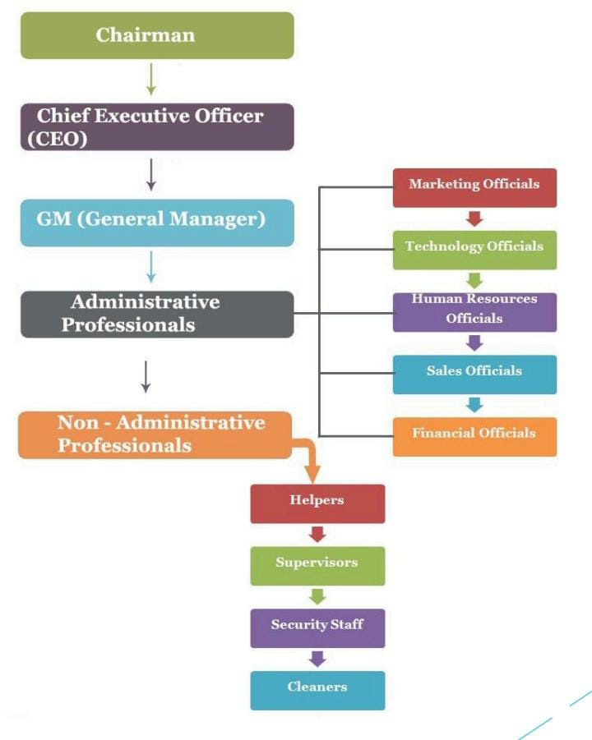
WHO ARE THE END USERS?

Slide 6
PROJECT OVERVIEW
Employee performance refers to how well an employee
fulfills their job duties and contributes to organizational
goals. It involves measuring productivity, quality of work,
efficiency, and overall contribution. Evaluating employee
performance helps identify strengths and areas for
improvement, guides development and training, informs
compensation decisions, and ensures alignment with
company objectives. Effective performance management
leads to motivated employees, better organizational
outcomes, and a clear path for growth and development

Slide 7
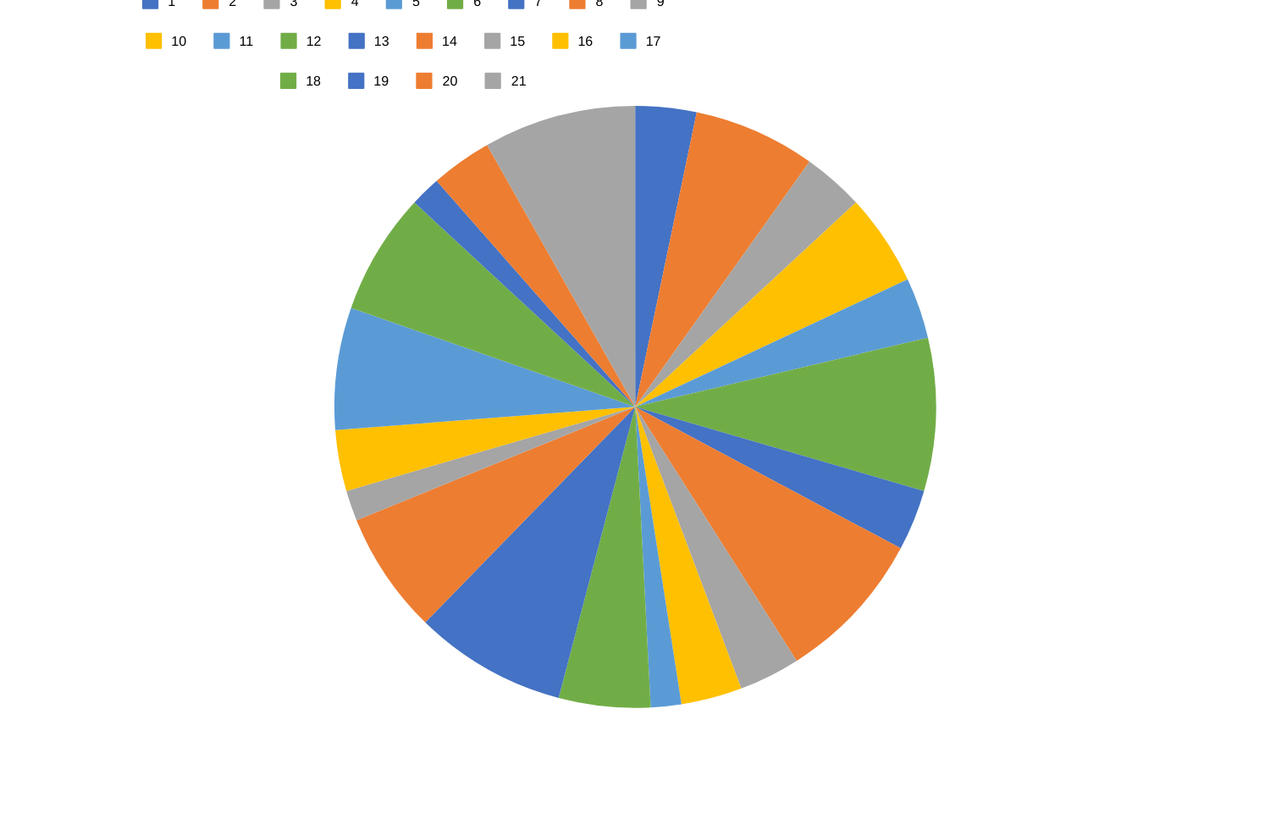
PIE CHART

Slide 8
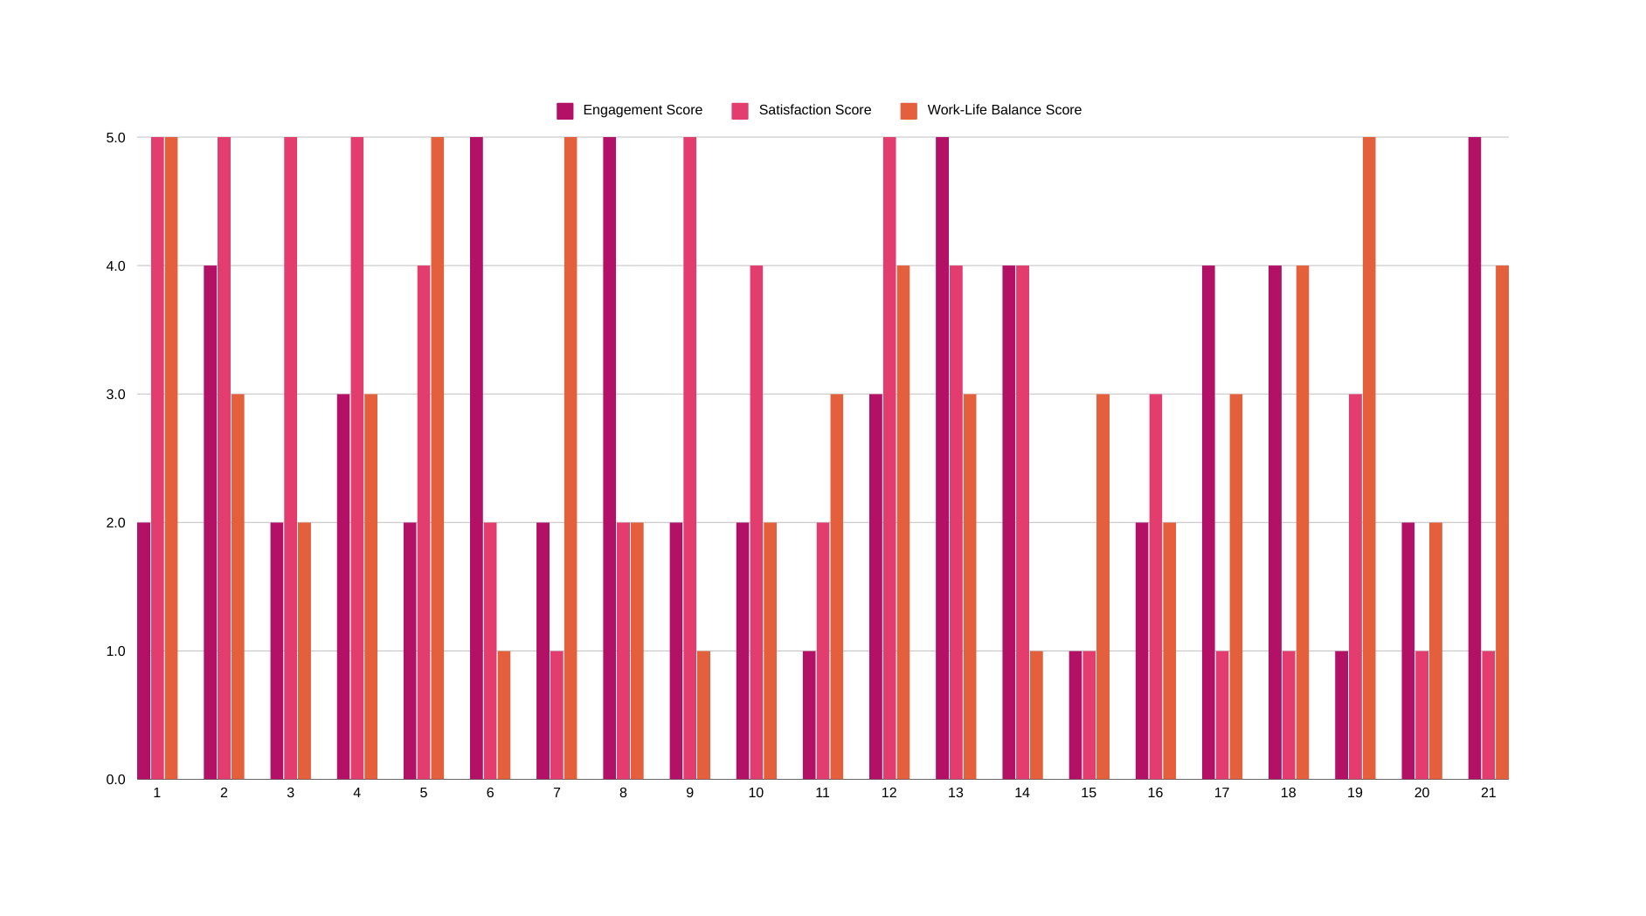
BAR DIAGRAM

Slide 9
PIVOT TABLE
Sum of Engagement Score | Sum of Satisfaction Score | Sum of Work-Life Balance Score
2 | 5 | 5
4 | 5 | 3
2 | 5 | 2
3 | 5 | 3
2 | 4 | 5
5 | 2 | 1
2 | 1 | 5
5 | 2 | 2
2 | 5 | 1
2 | 4 | 2
1 | 2 | 3
3 | 5 | 4
5 | 4 | 3
4 | 4 | 1
1 | 1 | 3
2 | 3 | 2
4 | 1 | 3
4 | 1 | 4
1 | 3 | 5
2 | 1 | 2
5 | 1 | 4

Slide 10
DATASET DESCRIPTION
EMPLOYEE ID NUMBER
SURVEY DATE
ENGAGEMENT SCORE
SATISFACTION SCORE
WORLD-LIFE SCORE BALANCE

Slide 11
CONCLUSION
In conclusion, effective employee performance management is essential for both
individual and organizational success. It ensures that employees are meeting
expectations, contributing to the company’s goals, and continuously developing their
skills. Regular performance evaluations not only drive motivation and productivity but
also enable informed decisions regarding promotions, compensation, and career
development. Ultimately, a strong focus on employee performance leads to a more
engaged, efficient, and successful workforce.

